Slide 1



Hello! What’s your name?
How old are you?
Where are you from?
How’s your day today?
L1
L2
How long have you been learning English?
L3
Notes:
Greet your student.
“Hello! What’s your name? Nice to meet you…”
“How old are you …?” (Ask student to answer in complete sentence)
“I’m from … Where are you from?” (For advanced student: I’m from … Have you ever been to …?)
“How’ your day today?”
“How long have you been learning English?”
Are you ready for our class?

Slide 2
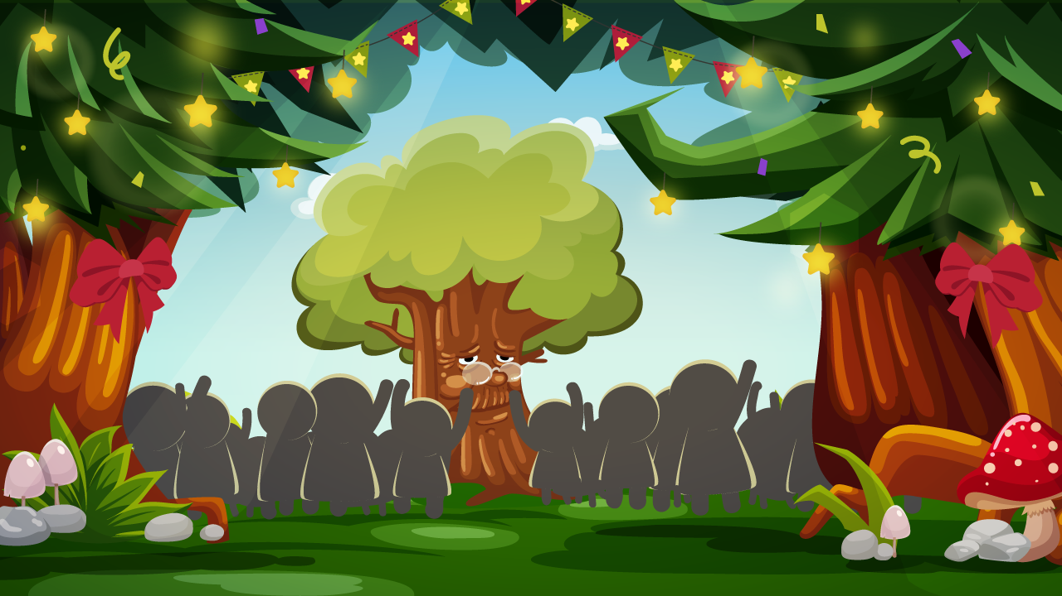



ABC Song
Listen! Someone is singing the ABC song! Let’s sing it together!
Notes:
Timing: 2 mins
Procedure:
Act “listen” and read CC’s lines.
Have S watch the ABC Song video on the next slide. If possible, have S sing the song with you.
Listen, CC! Someone is singing the ABC song in the hall! Let’s sing together! Are you ready? Let’s go!

Slide 3



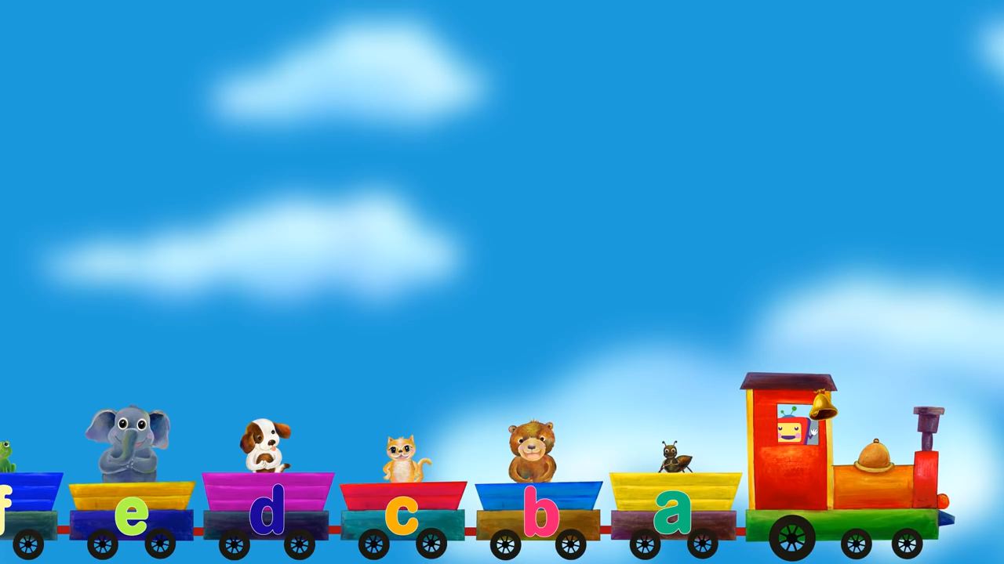

Notes:
Proper level: L1 (Phonics)
Language points: 26 letters and their sequence (capital letters and lower case ones)
Section：Can name and recognize letters
Timing: 1-2 minutes
Procedure:
Welcome S to the world of letters.
Click “play” to play the video
Ask S to sing together.

Slide 4









A is for apple, /æ/, /æ/, apple!
A is for ant, /æ/, /æ/, ant!
a
Notes:
Proper level: L1 (Phonics)
Language points: name and recognize simple nouns
Section：Can name and recognize simple nouns
Timing: 2-3 minutes
Procedure:
Ask S to read the letter A.
introduce the 2 words by pointing them and the pictures, then reads the chant in the white bubble before having S read together.

Slide 5
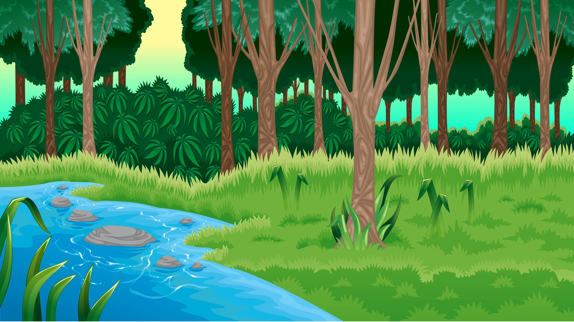




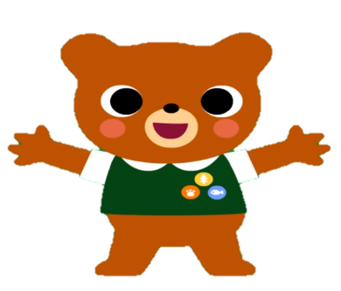


B is for ball, /b/, /b/, ball!
B is for bear, /b/, /b/, bear!
b
Notes:
Procedure:
Ask S to read the letter B.
introduce the 2 words by pointing them and the pictures, then reads the chant in the white bubble before having S read together.

Slide 6
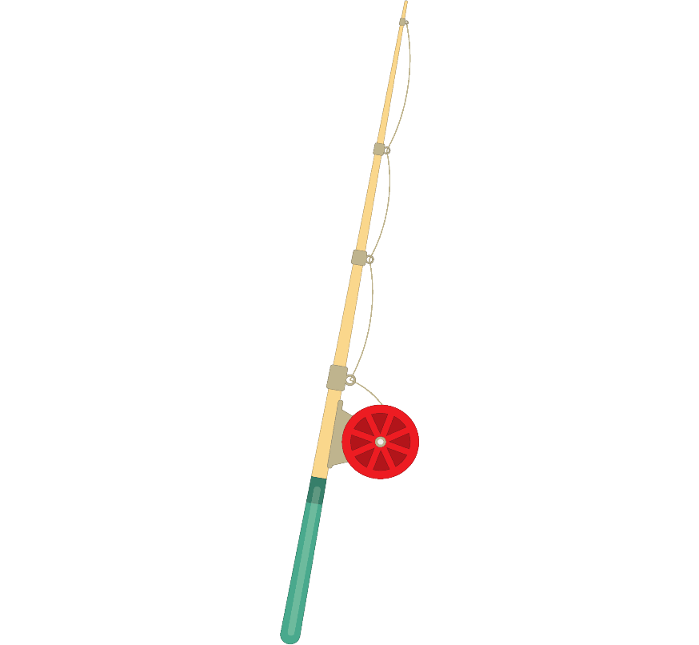







Great!
apple
apple
bear
ball
Notes:
Procedure:
T guides S to play the fishing game (matching words to the started letters). The first one (apple) is an example.

Slide 7

Well done!
ant
ant
ball
bear
Notes:
T guides S to play the fishing game (matching words to the started letters). The first one (apple) is an example.

Slide 8





Good job!
ball
apple
ball
ant
Notes:
T guides S to play the fishing game (matching words to the started letters). The first one (apple) is an example.

Slide 9


amazing!
bear
ant
apple
L1
L2
bear
L3
S
Notes:
T guides S to play the fishing game (matching words to the started letters). The first one (apple) is an example.

Slide 10


c
at
Click the letters and say aloud. Then click the picture, look and say.
cat
Notes:
Proper level: L1 (Phonics)
Language points: the sound of c/r/m; blend of at
Section: CVC words presentation (slide 3-5)
Timing: 2-3 minutes (0.5-1 minutes per slide)
Procedure:
Tell S he’s/she’s going to meet some friends from alphabet world.
Click c and say the sound /k/ aloud. Have S repeat after you.
Click at and say the sound /æt/ aloud. Have S repeat after you.
Click the cat and say “/k/ /æt/ /kæt/”. Watch c and at move together. Have S repeat after you.

Slide 11

r
at
Click the letters and say aloud. Then click the picture, look and say.
rat
Notes:
Procedure:
Click r and say the sound /r/ aloud. Have S repeat after you.
Click at and say the sound /æt/ aloud. Have S repeat after you.
Click the rat and say “/r/ /æt/ /ræt/”. Watch r and at move together. Have S repeat after you.

Slide 12

m
at
Click the letters and say aloud. Then click the picture, look and say.
mat
Notes:
Procedure:
Click m and say the sound /m/ aloud. Have S repeat after you.
Click at and say the sound /æt/ aloud. Have S repeat after you.
Click the mat and say “/m/ /æt/ /mæt/”. Watch m and at move together. Have S repeat after you.

Slide 13





Where’s the ?
cat
Here is the cat!
Notes:
Procedure:
Tell S here is a show.
Have S look at the picture, read the question to S (click again till word “cat” fall), have S click the correct shadow.
The correct shadow will change into the colorful picture.
Have S say the appeared answer “Here is the cat”.

Slide 14

Where’s the ?
rat
Here is the rat!
Notes:
Procedure:
Tell S here is a show.
Have S look at the picture, read the question to S (click again till word “rat” fall), have S click the correct shadow.
The correct shadow will change into the colorful picture.
Have S say the appeared answer “Here is the rat”.

Slide 15
Where’s the ?
mat
Here is the mat!
Notes:
Procedure:
Tell S here is a show.
Have S look at the picture, read the question to S (click again till word “mat” fall), have S click the correct shadow.
The correct shadow will change into the colorful picture.
Have S say the appeared answer “Here is the mat”.

Slide 16
Here is the cat!
Here is the rat!
Here is the mat!
The cat and the rat are on the mat!
Notes:
Procedure:
Have S look at the picture, click each sentence to see the pictures shine accordingly.
Have S read each sentence or repeat after you if he/she struggles.
The last sentence is a little bit challenging so provide more support to help them read aloud.

Slide 17
The _____ and the _____ are on the _____!
Notes:
Procedure:
Tell S to complete the sentence with learned words (cat/rat/mat) on their own.
Click the pictures to elicit these words when S struggles.

Slide 18

cat
rat
mat
The _____ and the _____ are on the _____!
L1
L2
L3
S
Notes:
Procedure:
Tell S it’s time to check his/her answers.
Click each picture and the word will fall into the correct blank.
Say the sentence aloud again. You can also have S read it on his/her own.

Slide 19



Let’s find the stationaries we need. Shoot the balloon to get the stationary.
Notes:
Proper level: L2
Language points: words classroom items and stationaries;
Section: Can name and recognize classroom objects
Timing: 4-8 minutes (0.5-1 minutes per slide)
Procedure:
Tell S it’s time to play a game: help CC find the….
2. T: What do we need for school? Do we need pencils?
S: Yes, we do.
T: What else do we need for school?
S: We need…
(T guides S to say complete sentence)

Slide 20









a green rubber
Notes:
Procedure:
Ask student to shoot the balloon to get the green rubber （click the bubble to shoot）
T: How many rubbers can you see?
S: I can see two rubbers.
T: Can you see the green rubber? You can shoot it. Click to shoot the balloon.
S: OK. (Student shoot the balloon to get the green rubber)

Slide 21
a red pencil
Notes:
Procedure:
Student shoots the balloon to get the red pencil
T: How many pencils can you see?
S: I can see one pencil.
T: Can you shoot the balloon with the red pencil?

Slide 22
a blue book
Notes:
Student shoots the blue to get the blue book

Slide 23
an orange pen

Slide 24
a red pencil case

Slide 25
a blue rubber

Slide 26


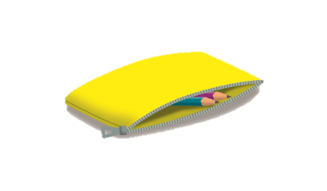





How many _______ can you see?
I can see ______ ______.
L1
L2
L3
S
Notes:
Procedure:
Ask student to count the items. ‘This is the stationeries you have got. How many…’
Ask student to circle if necessary.

Slide 27



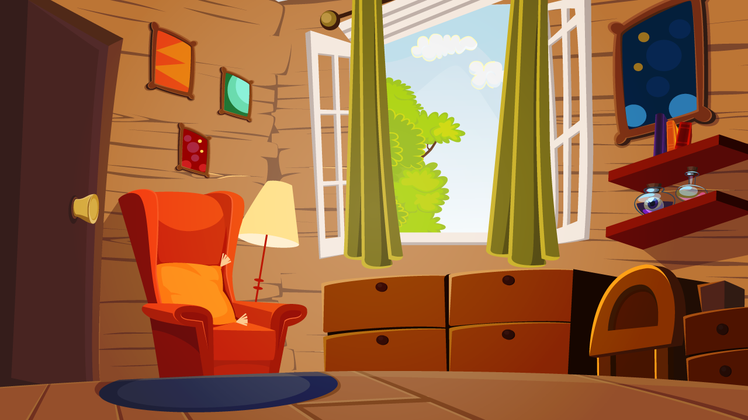


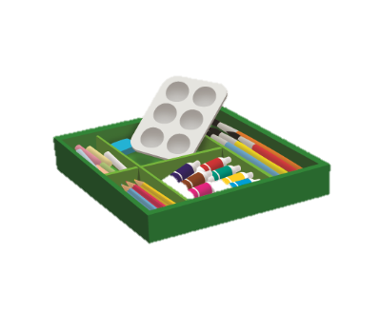



















Words
Notes:
Proper level: L2
Language points: names of times
Section: Can name and recognize toys/presents
Timing: 2-3 mins
Procedure:
Set up the story. Today is CC’s birthday. CC has got many presents.
Find out CC’s presents. Let’s click to see(what the present is).

Slide 28
Words
robot
ball
doll
kite
art set
bike
computer
camera
teddy bear
computer game
Notes:
Timing: 1 min
Procedure:
1. Get students to review the words. Read the words together.

Slide 29

Words
Notes:
Timing: 0.5 min
Procedure:
Set up the story. A tornado blows CC’s presents away.

Slide 30



The tornado blows all the presents away. Let’s help CC find the presents.
Notes:
Timing: 0.5 min
Procedure:
Set up the story. Let’s help CC find the presents.

Slide 31



This is the dark forest. Where are CC’s presents?
Notes:
Timing: 0.5 min
Procedure:
Set up the story. We come to the dark forest. It’s so dark here. Where are CC’s presents?

Slide 32



What is it?
It’s a/an ______.
Notes:
Timing: 1 min
Procedure:
Explain the task. Look carefully. What is it? (Ask student to answer in complete sentence.)

Slide 33

What is it?
It’s a/an ______.
Notes:
Timing: 1 min
Procedure:
Explain the task. Look carefully. What is it? (Ask student to answer in complete sentence.)

Slide 34

What is it?
It’s a/an ______.
Notes:
Timing: 1 min
Procedure:
Explain the task. Look carefully. What is it? (Ask student to answer in complete sentence.)

Slide 35

What is it?
It’s a/an ______.
Notes:
Timing: 1 min
Procedure:
Explain the task. Look carefully. What is it? (Ask student to answer in complete sentence.)

Slide 36







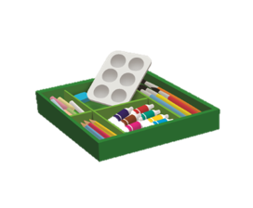


Wow, we found all the presents.
Notes:
Timing: 0.5 min
Procedure:
1. Set up the story.

Slide 37



Thank you! I have a present for you!
What’s this?
Notes:
Timing: 1 min
Procedure:
Interact with the student. Ask student what the present is. What’s this? Student should guess, Is it a …? Student keeps guessing until find the correct answer. (a robot)

Slide 38

Yes! It is a robot!
Do you like the robot?
What’s your favorite present?
L1
L2
L3
S
Notes:
Timing: 1 min
Procedure:
Ask some follow up questions to dig deeper.

Slide 39



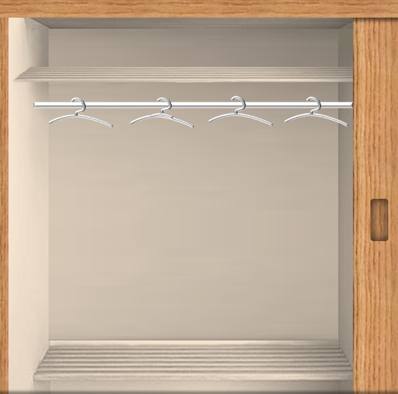
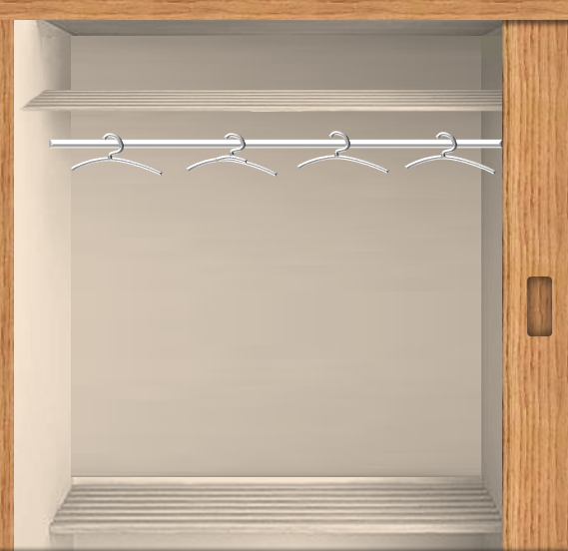





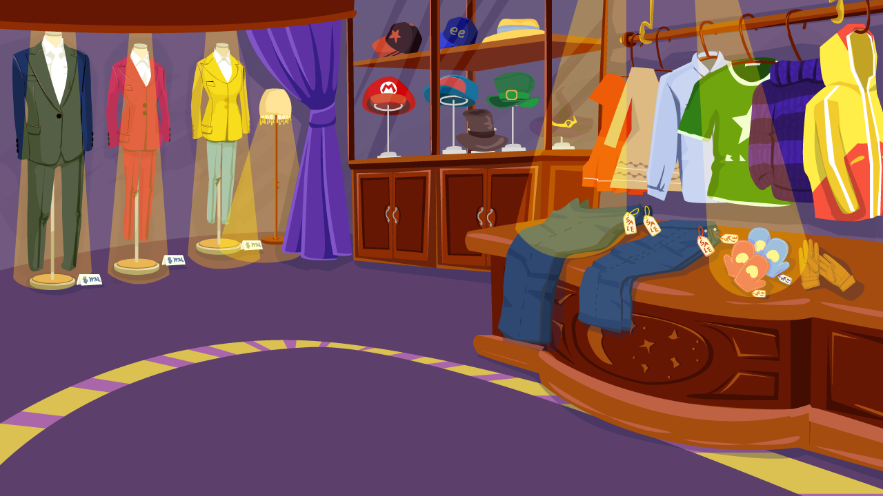



























sweater
Notes:
Proper level: L3
Language points: names of clothes
Section: Can name and recognize clothing items
Timing: 2 mins each slide
Procedure:
Set up the story. This is tom. Let’s help him to dress up, ok?
Point to the bubble, and ask ‘what does he need?’
Ask student to click the right piece of clothes
Say ‘wow, tom is wearing a sweater. Good job.’

Slide 40
socks

Slide 41
jeans

Slide 42
boots

Slide 43
wooly hat

Slide 44
coat

Slide 45
scarf

Slide 46
hand bag

Slide 47

L1
L2
L3
S
Notes:
Proper level: L3
Language points: present continuous tense (be wearing…)
Section: Can name and recognize clothing items
Timing: 2 mins
Procedure:
Set up the story. Now, Tom is dressed up. Let’s look into the mirror (click the mirror.) Oh, Tom looks different! What’s wrong with Tom?
Ask student to answer by using ‘tom is wearing a brown coat, he is not wearing a blue shirt.’

Slide 48



Can you help me to find my animals?
Notes:
Proper level: L3
Language points: words of animals; V-ing verbs; present continuous tense
Section: Can use present continuous tense to describe actions
Timing: 1-2 minutes each slide
Procedure:
Set up the story. ‘Uncle Jim is a farmer. The animals in the farm are missing. Let’s help him to find them .

Slide 49
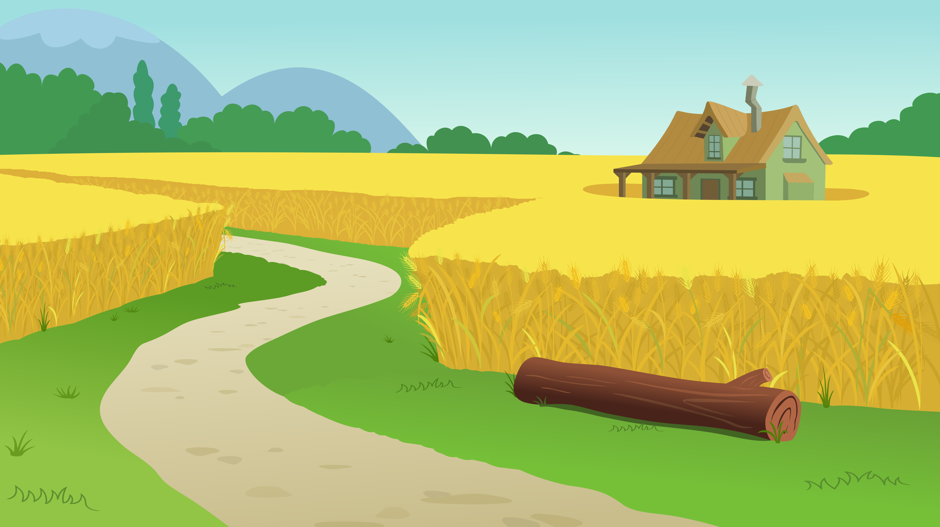



The mouse is eating cheese.
Notes:
Proper level: L3
Language points: words of animals; V-ing verbs; present continuous tense
Section: Can use present continuous tense to describe actions
Timing: 1-2 minutes each slide
Procedure:
Ask ‘is any animal here?’
Get S’s attention to the timber. Look here. is someone behind the timber？
get Ss to click the timber to find out.
get Ss to say what the animal is and what he is doing.

Slide 50



The cat is sleeping.
Notes:
Procedure:
Ask student to pay attention to the sound. Listen! What’s the sound? Someone is sleeping.
get Ss to guess where the sound comes out. where does the sound come out? let’s click to find out.
get Ss to say what the cat is doing.

Slide 51
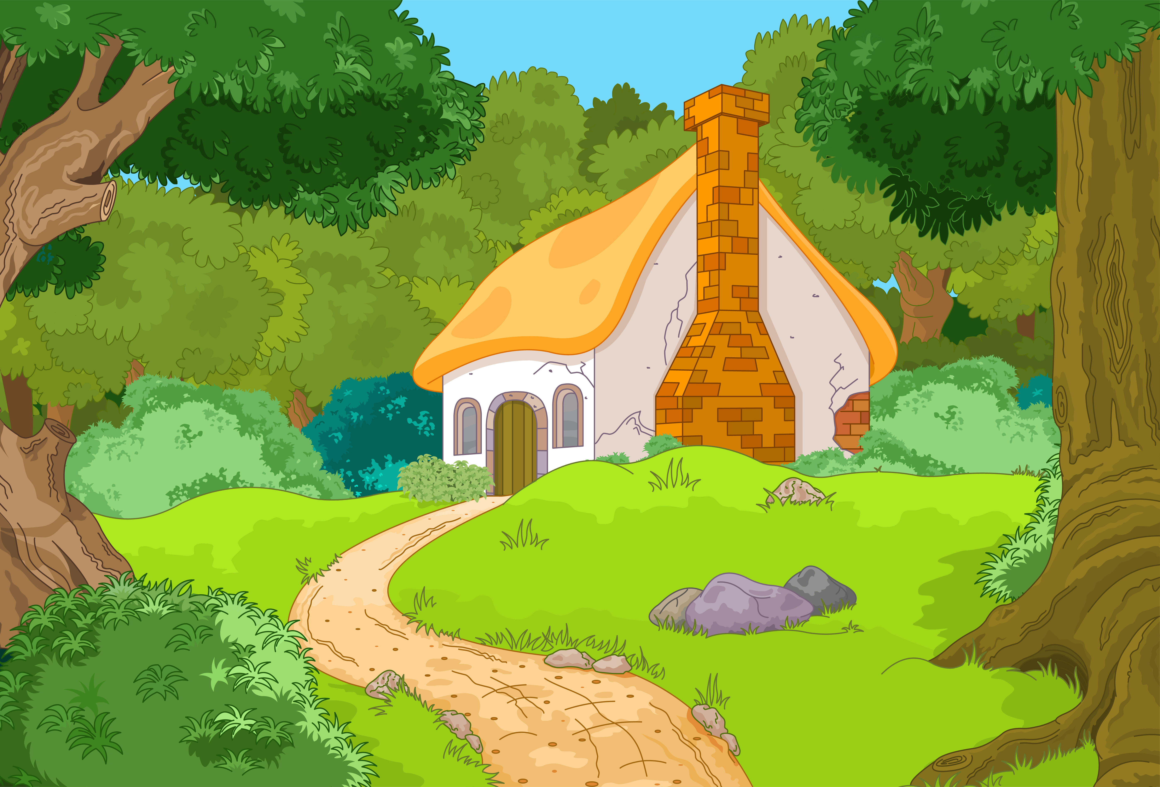




The monkey is chasing the butterfly.
Notes:
Procedure:
Ask student ‘what can you see?’ what the butterfly is doing？
Cilck the butterfly and a monkey appears. Wow. A monkey is here. What is the monkey doing?

Slide 52



The dog is swimming.
L1
L2
L3
S
Notes:
Procedure:
Ask student ‘what can you see?’ can you see the bubbles? Who is here?
Cilck the bubble. ‘wow, it’s a dog. What is he doing?

Slide 53


Goodbye
I had a great time!
See you next time!
Notes:
Timing: 1 minute
Procedure:
Imitate CC and the letters to read the lines along with the automatic animation.
Say goodbye to S.

